Slide 1
Reassortment figures
10/15/2024

Slide 2
Treesort outputs

Slide 3
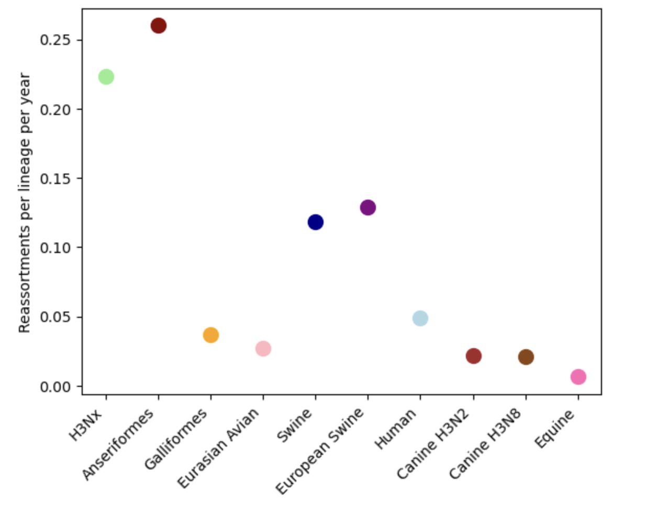
Reassortment rates by host lineage calculated by TreeSort

Slide 4
All swine

Slide 5
All birds

Slide 6
human

Slide 7
Next figures are segment identities of reassortment events involving 1,2, or 3 segments. For swine and birds.

Slide 8
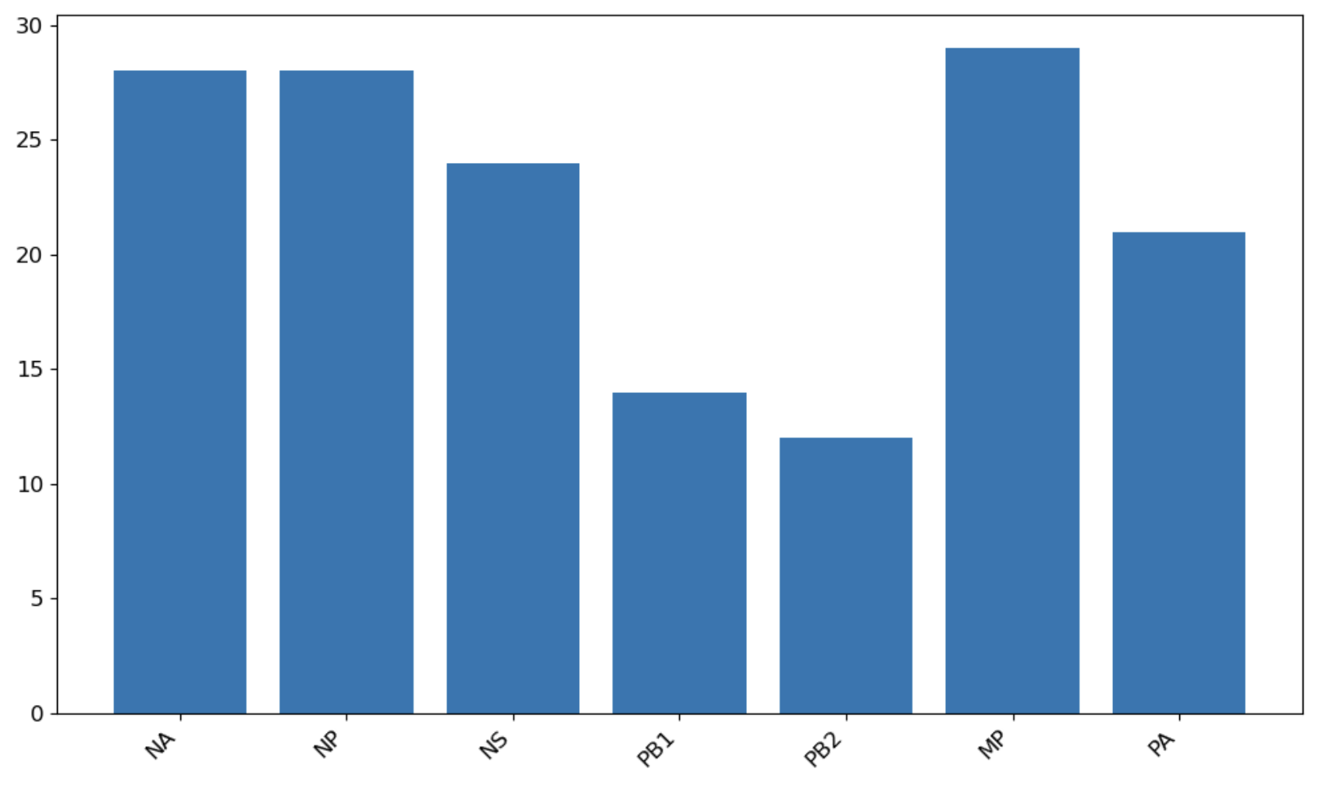

One segment

Slide 9
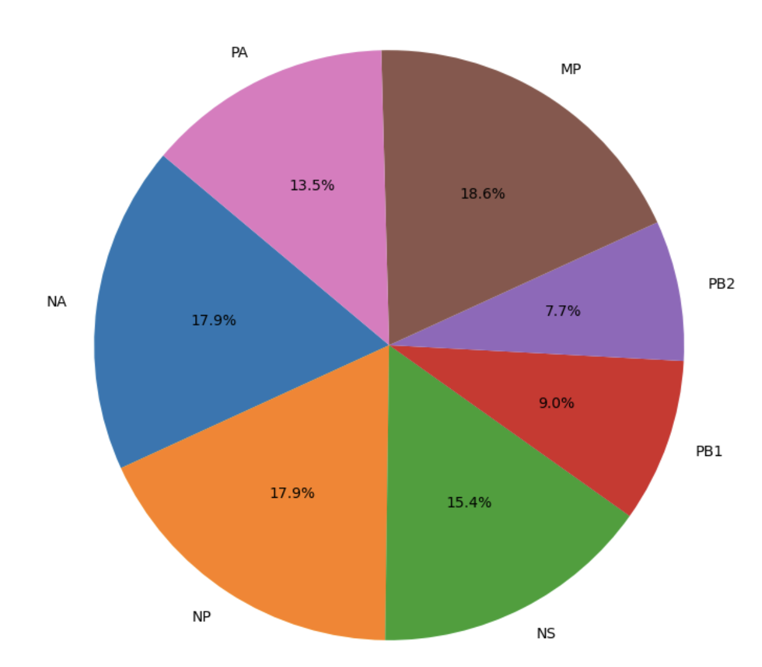
One segment

Slide 10
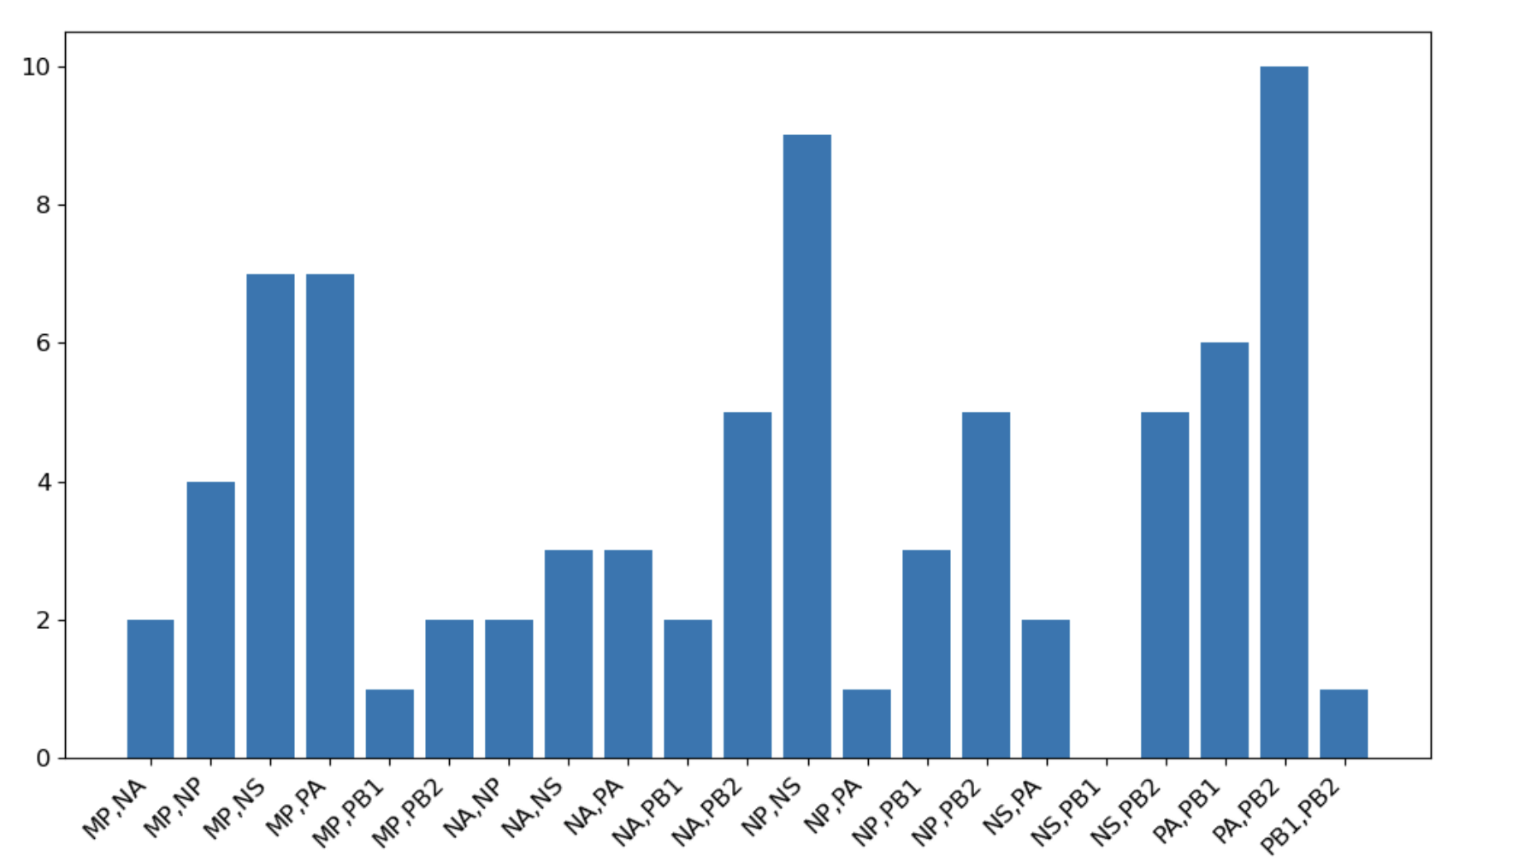
two segment

Slide 11
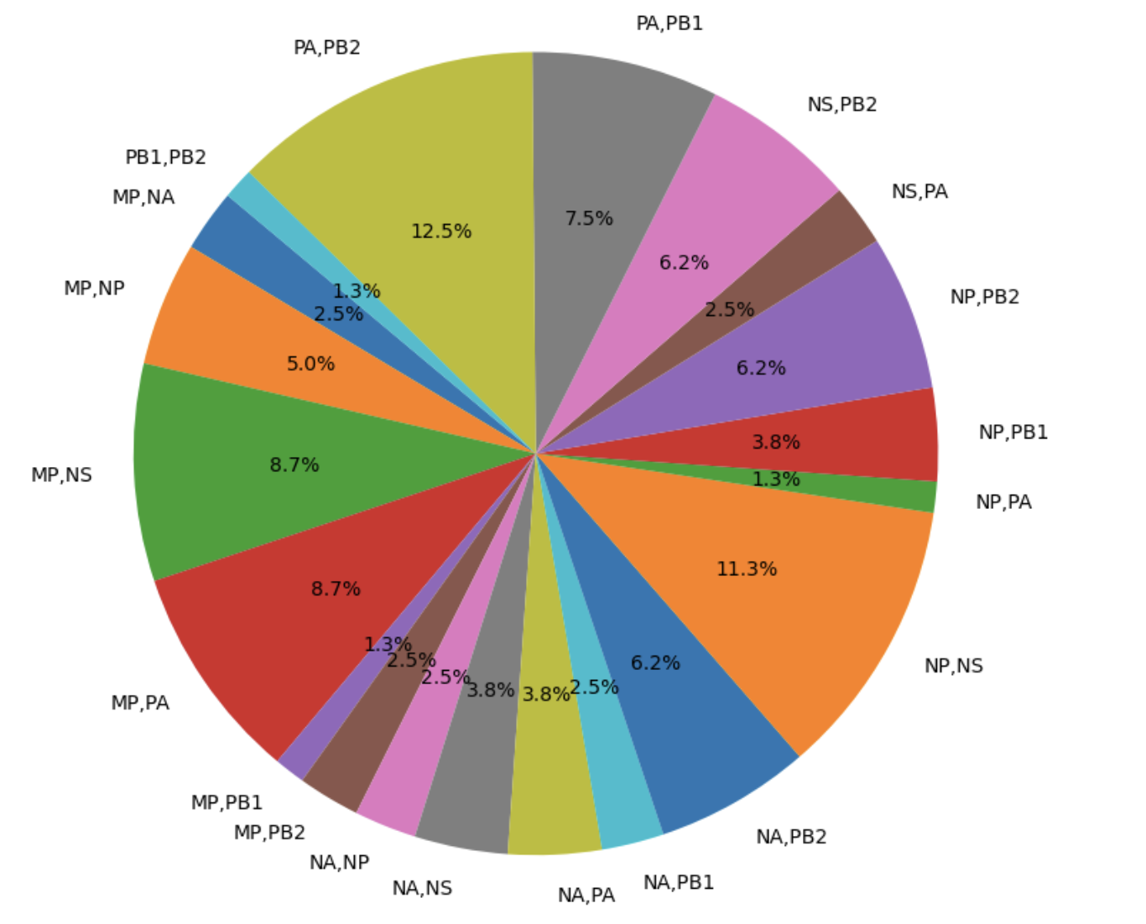
two segment

Slide 12
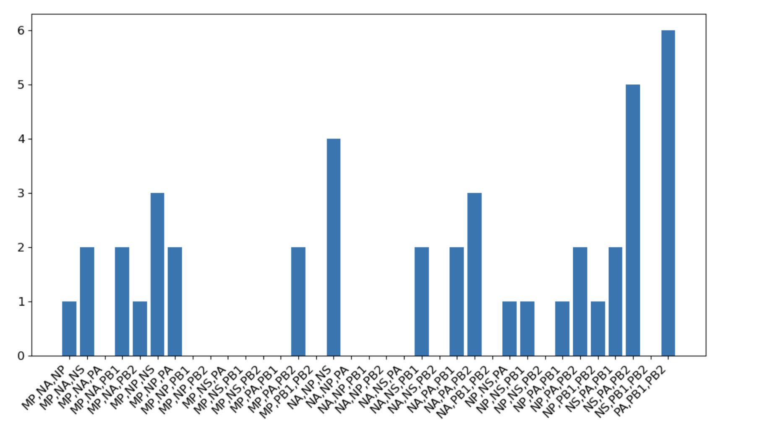
three segment

Slide 13
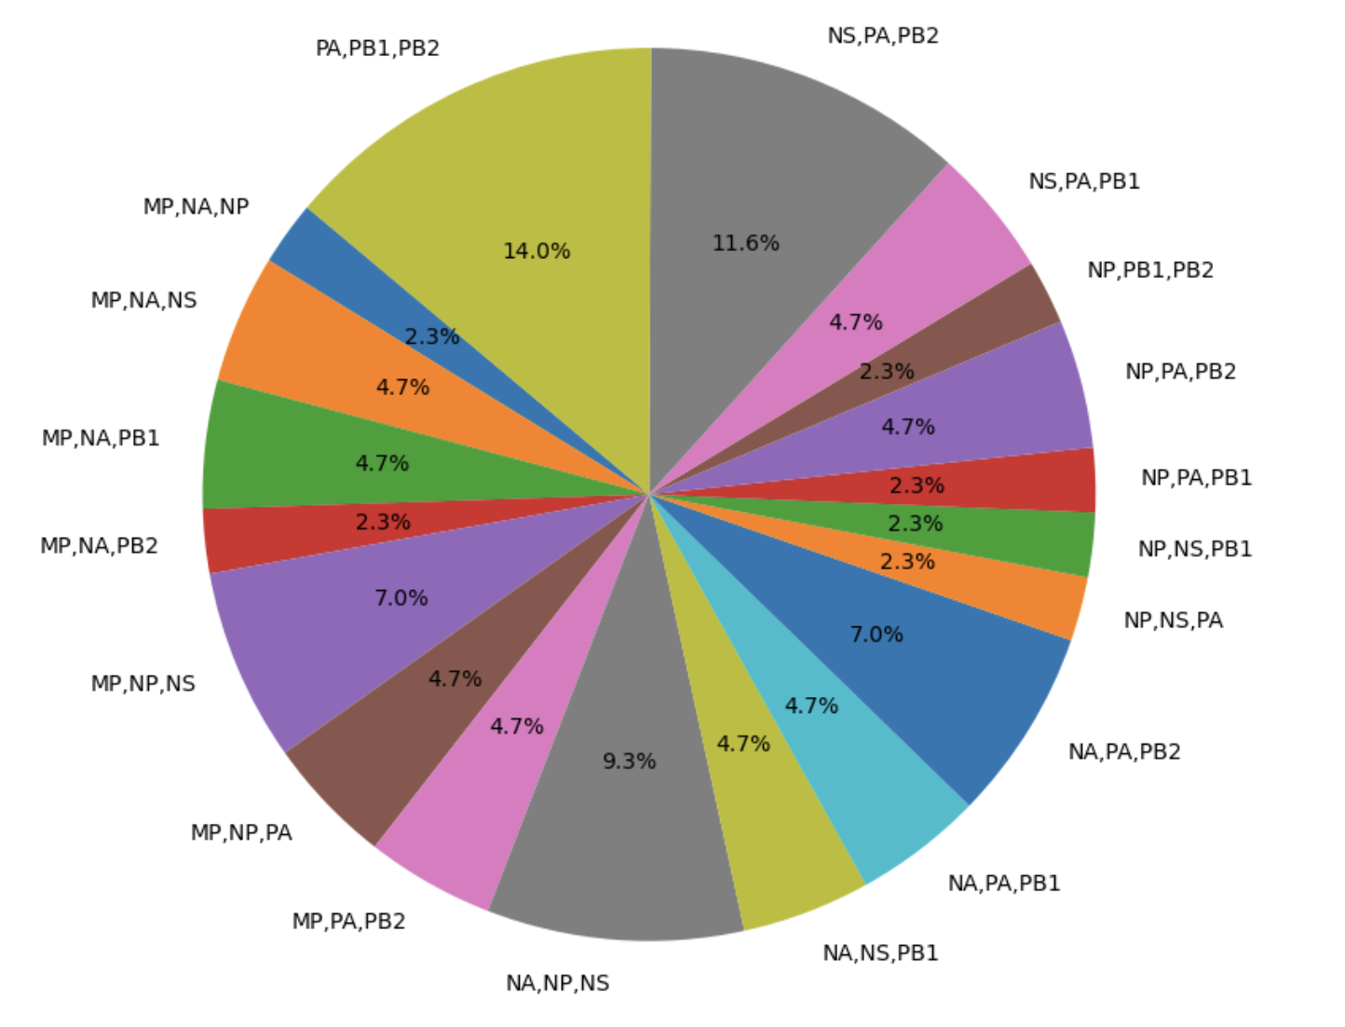
three segment

Slide 14
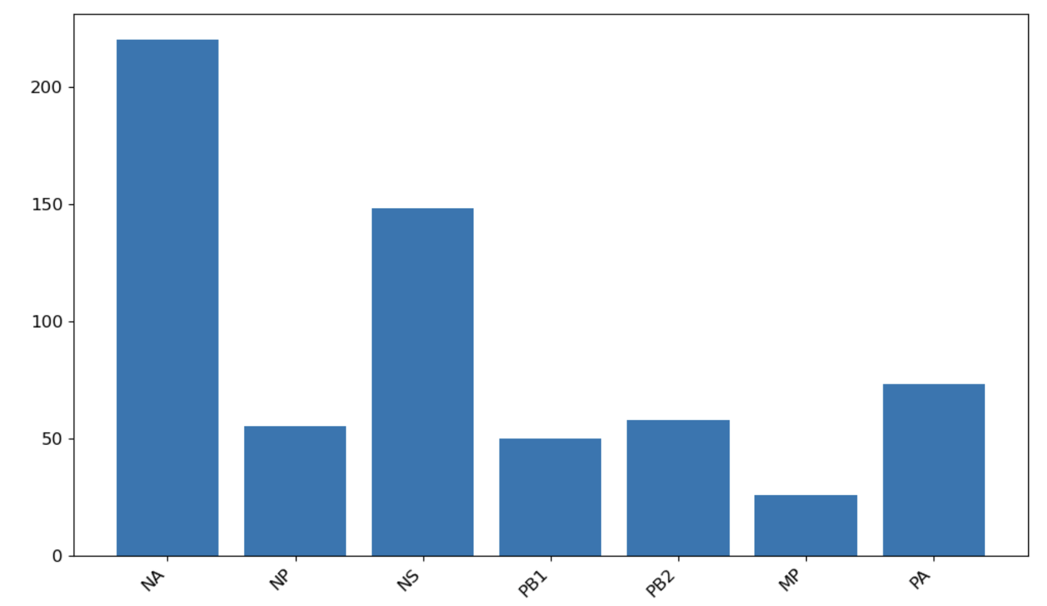

One segment

Slide 15
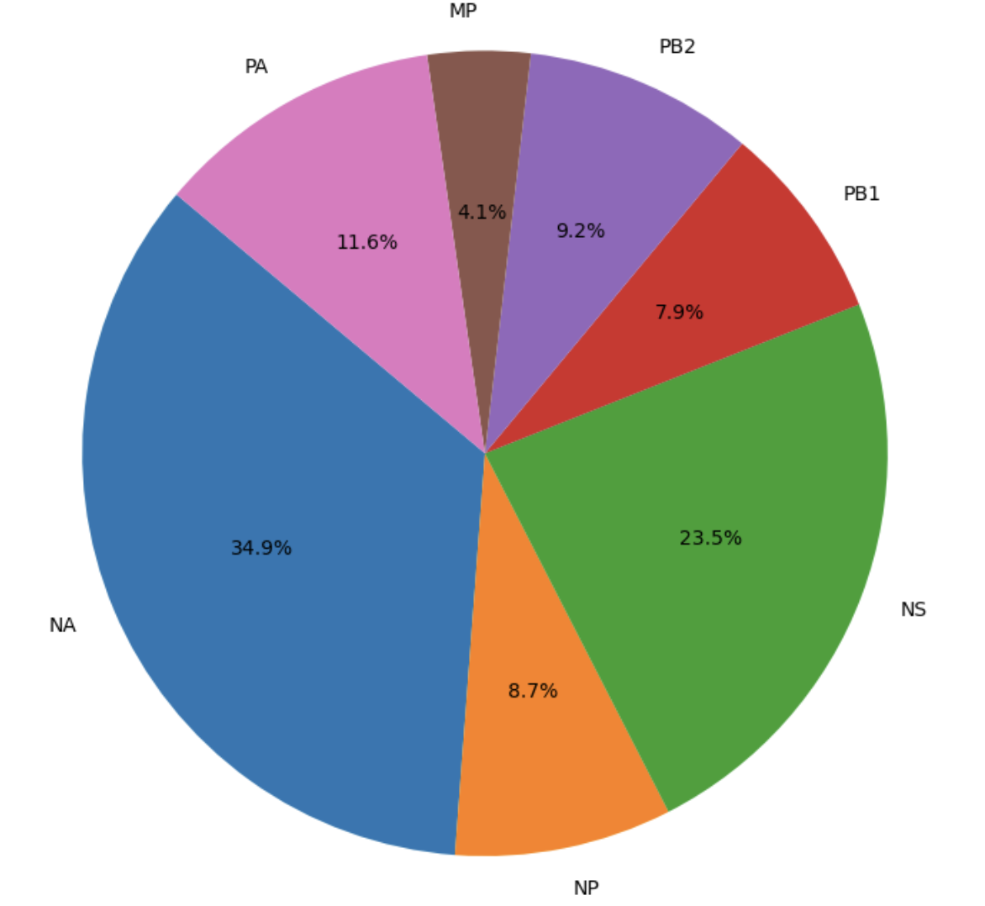
One segment

Slide 16
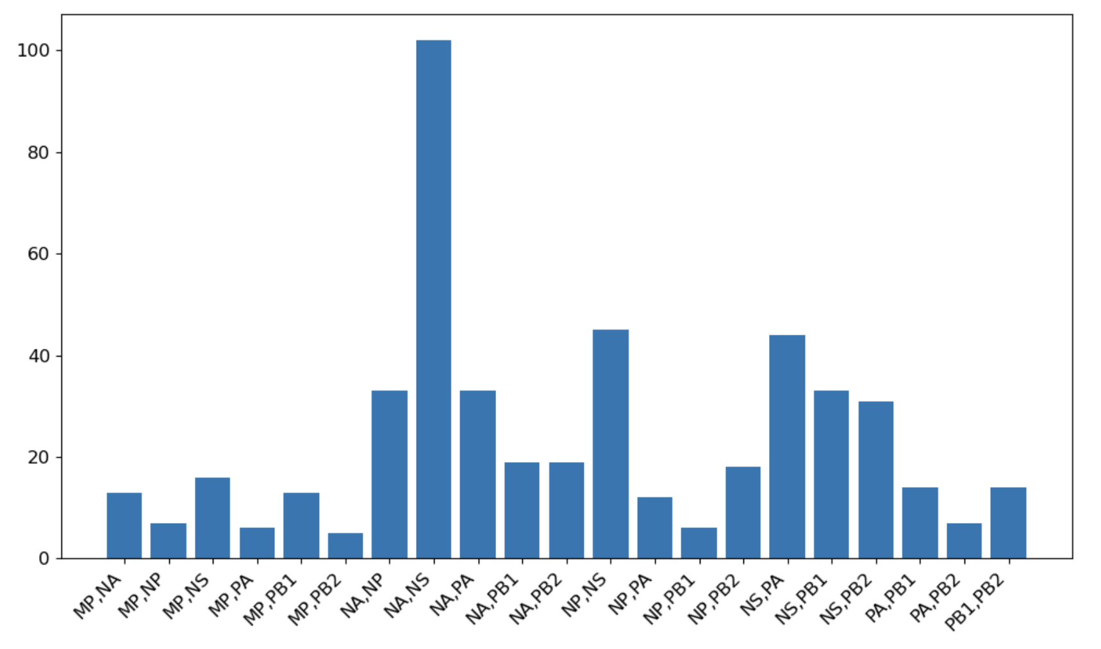
two segment

Slide 17
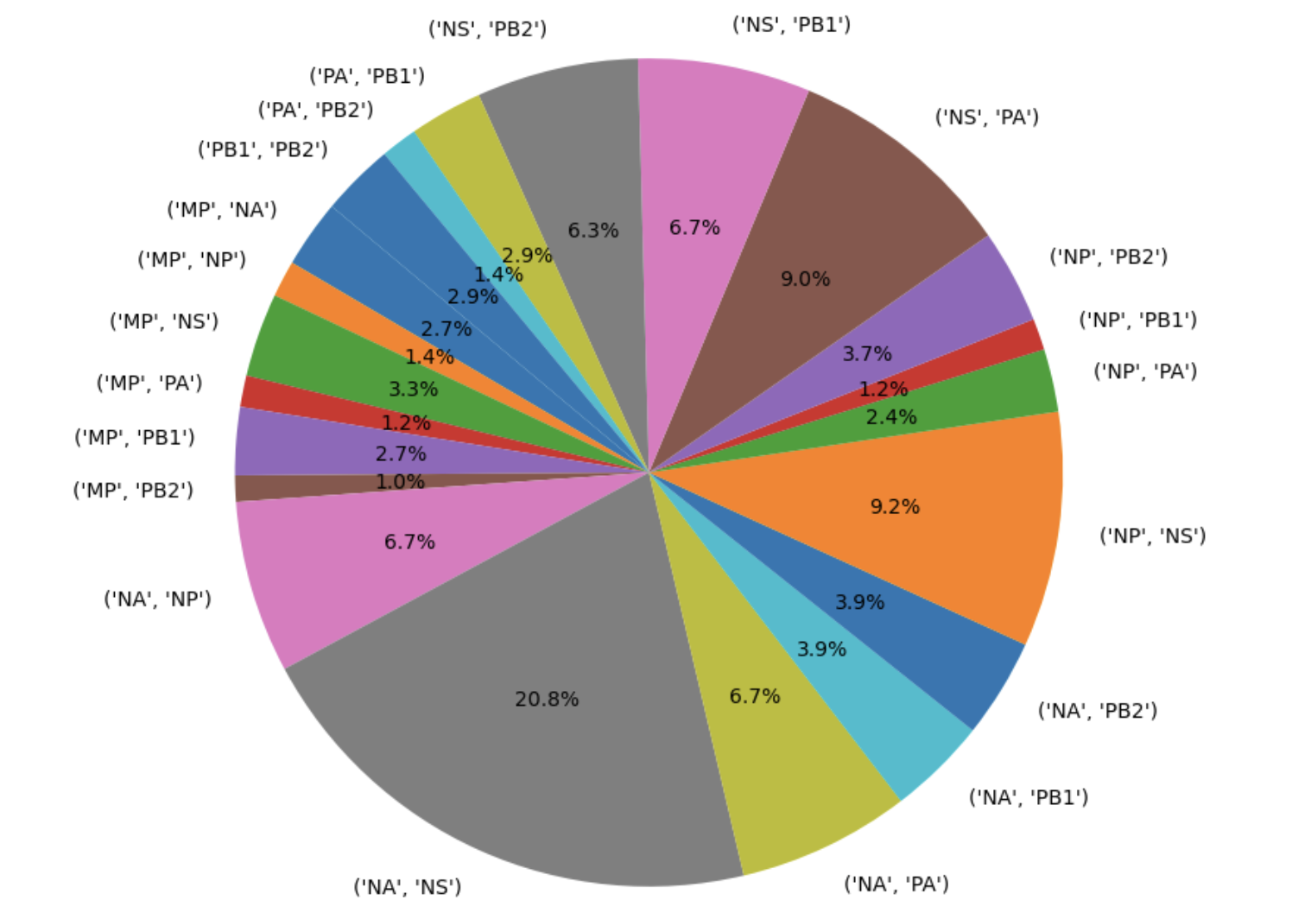
two segment

Slide 18
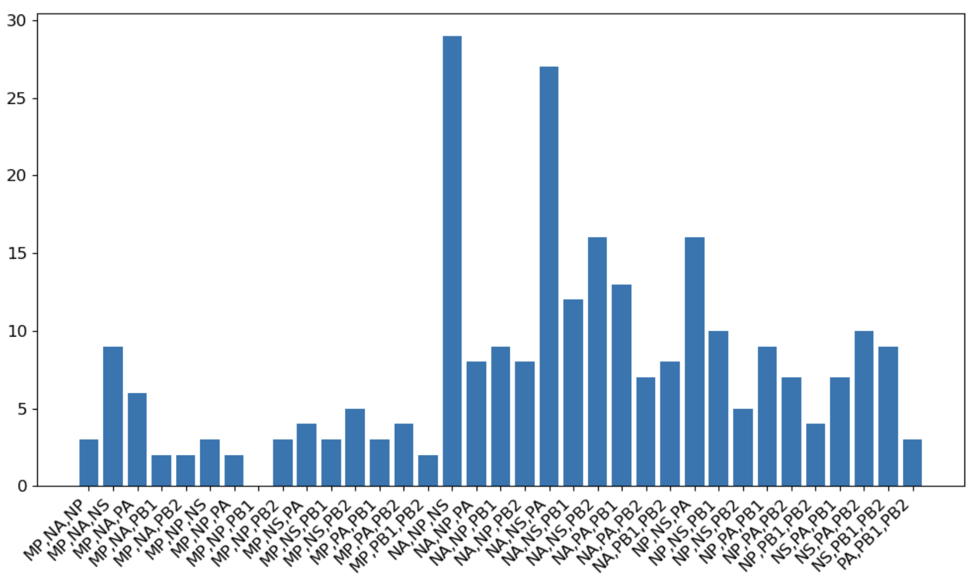
three segment

Slide 19
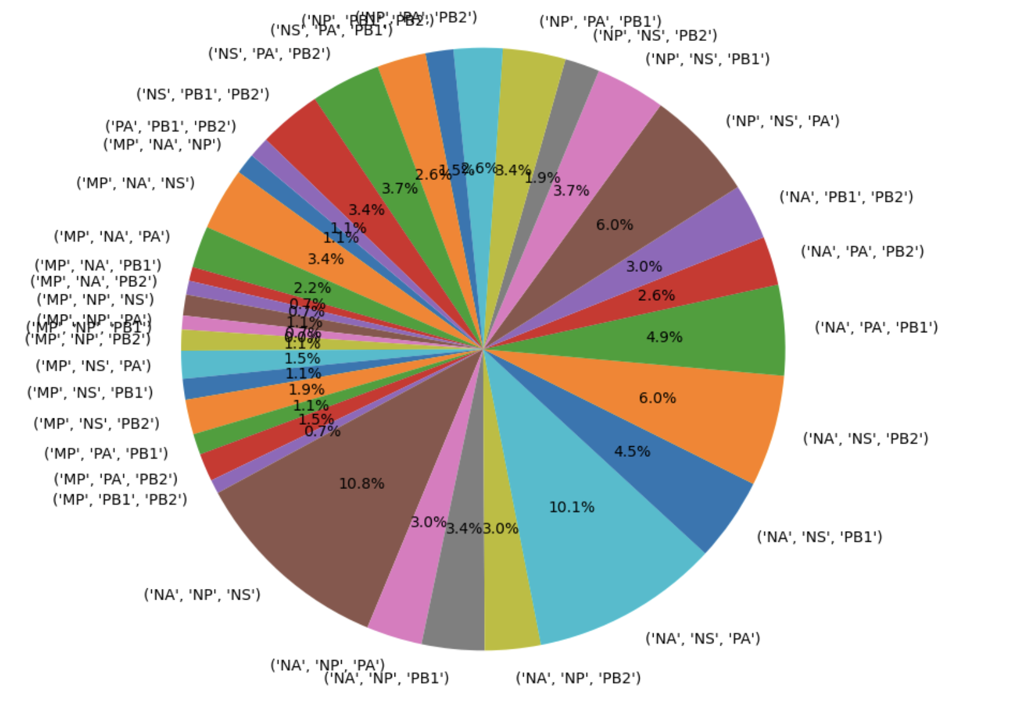
three segment

Slide 20
Next figures are network visualizations for reassortment events involving 2, 3, or 4 segments or the whole tree.

Slide 21
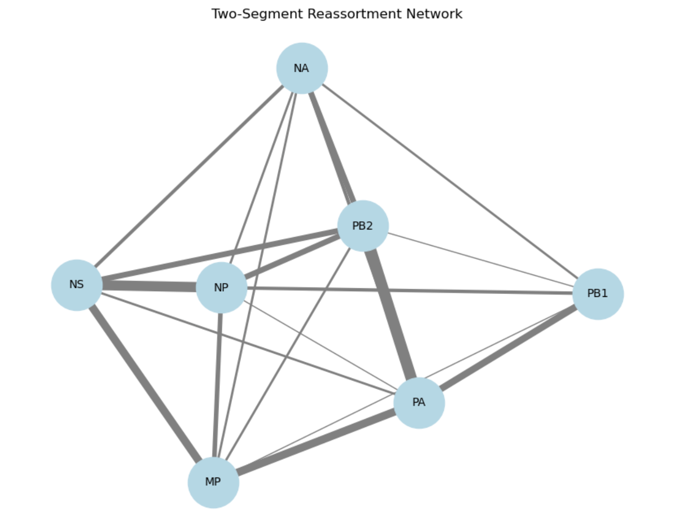
Network vis
This is for reassortment events involving 2 segments

Slide 22
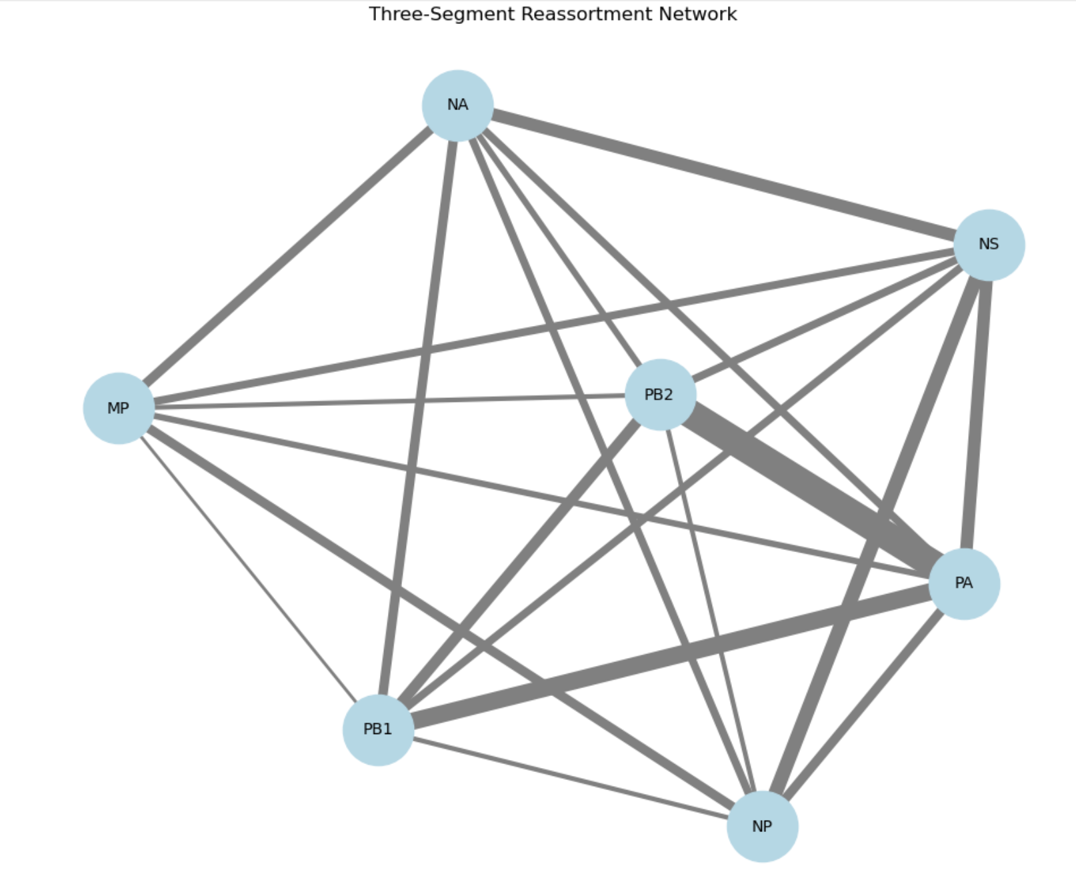
Network vis
This is for reassortment events involving 3 segments

Slide 23
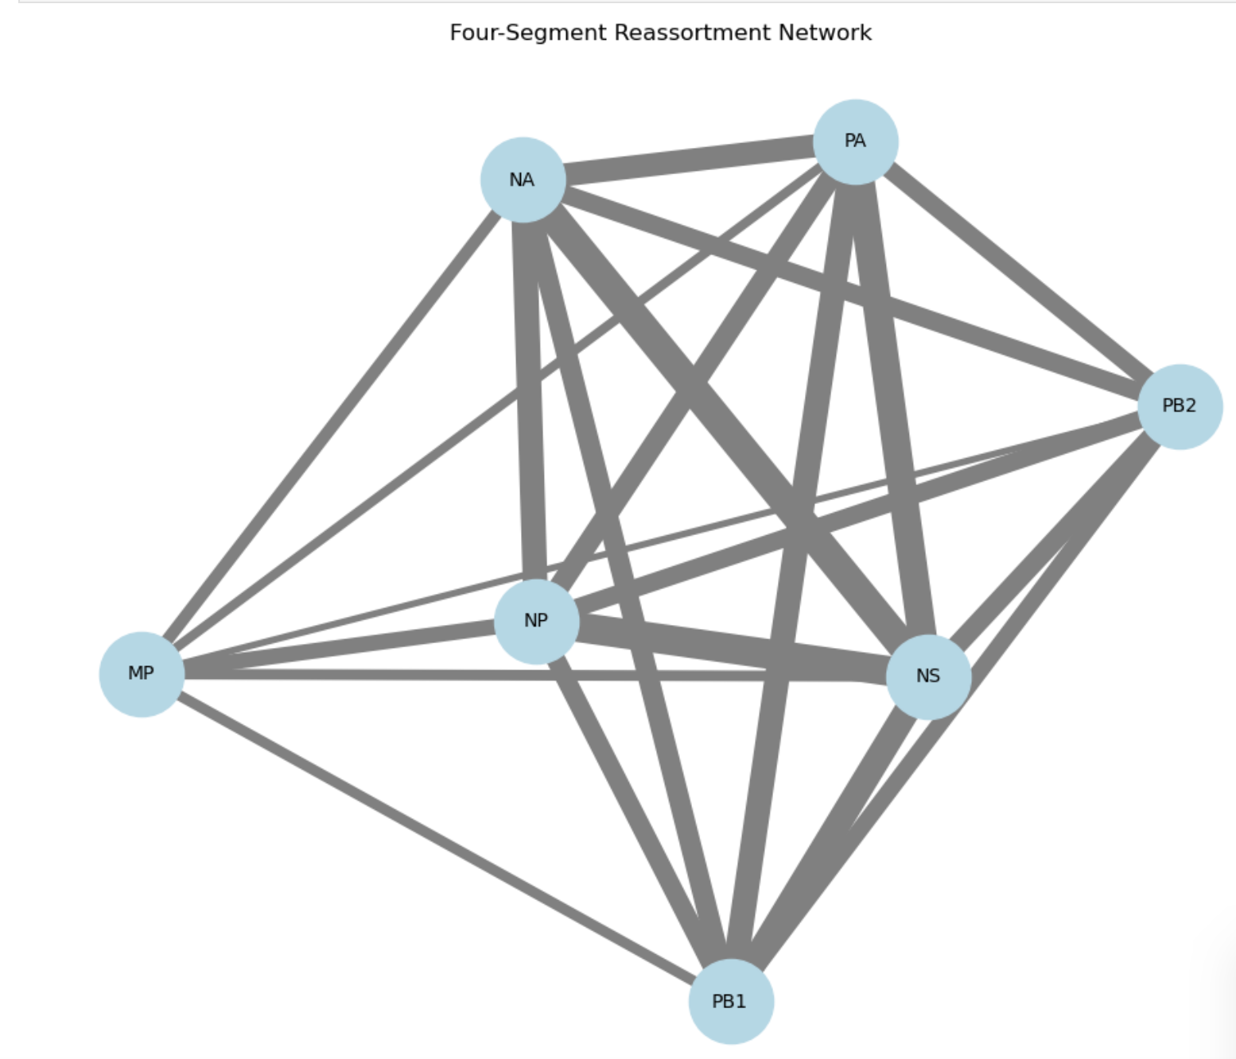
Network vis
This is for reassortment events involving 4 segments
Thickness scaled by a factor 0.3

Slide 24
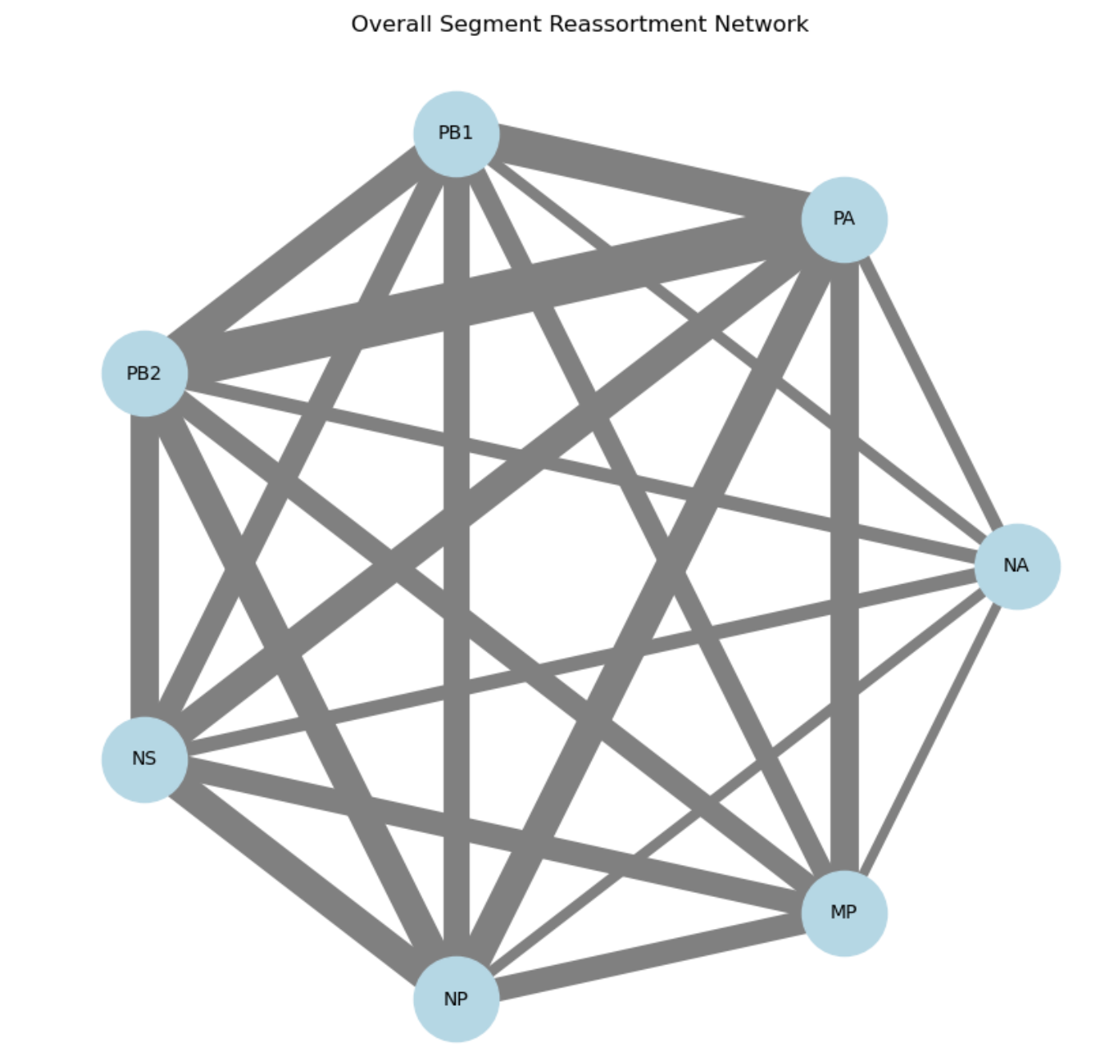
Network vis
This is for whole tree
Thickness scaled by a factor 0.3

Slide 25
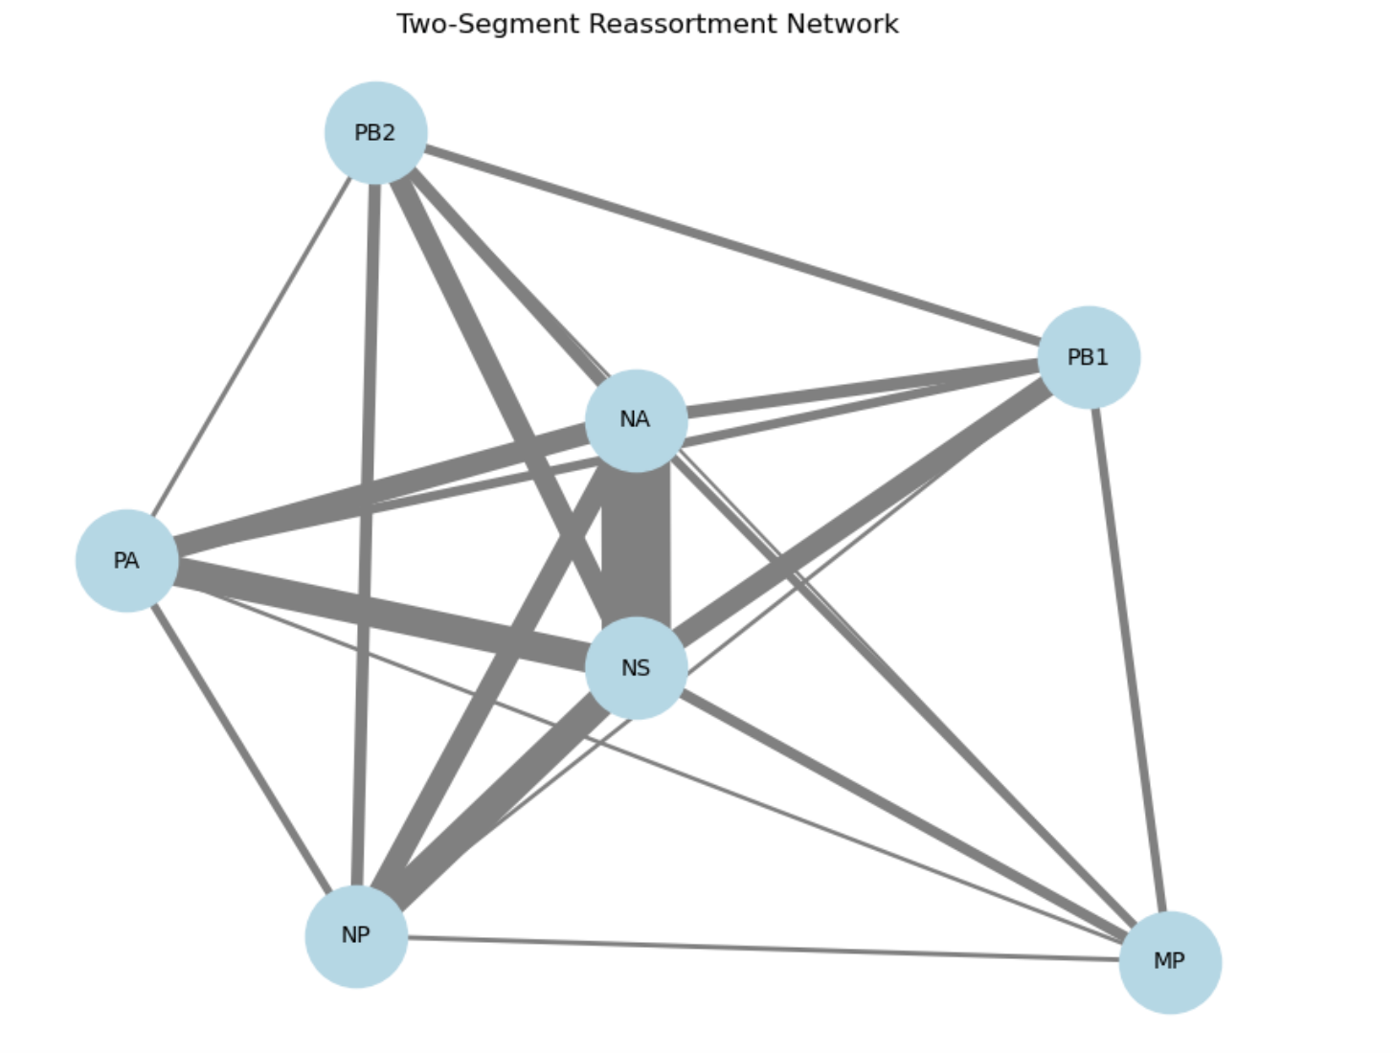
Network vis
This is for reassortment events involving 2 segments
Thickness scaled by a factor 0.3

Slide 26
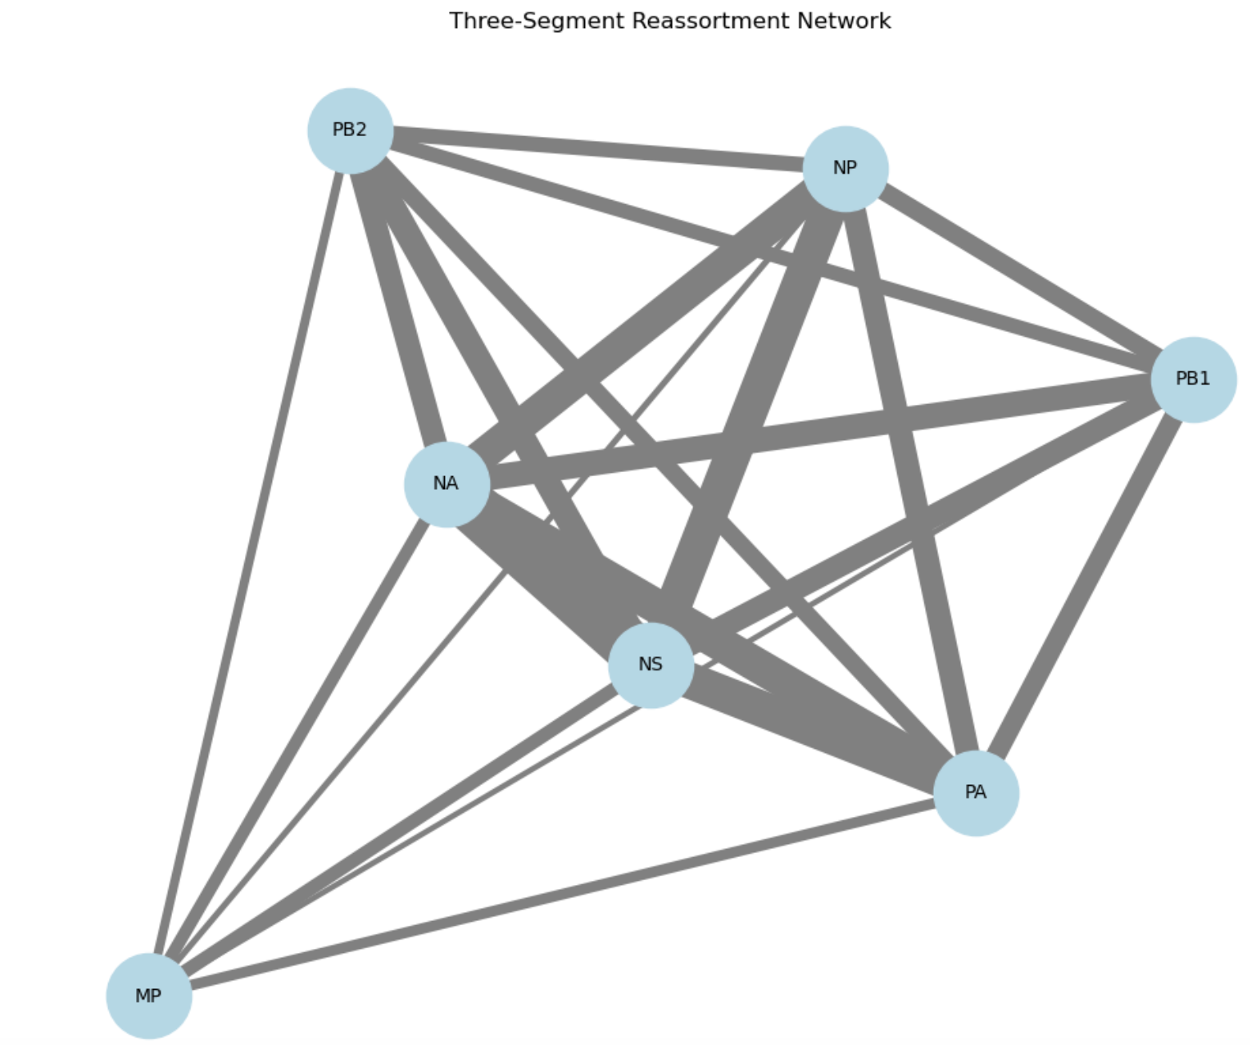
Network vis
This is for reassortment events involving 3 segments
Thickness scaled by a factor 0.3

Slide 27
Network vis
This is for reassortment events involving 4 segments
Thickness scaled by a factor 0.3

Slide 28
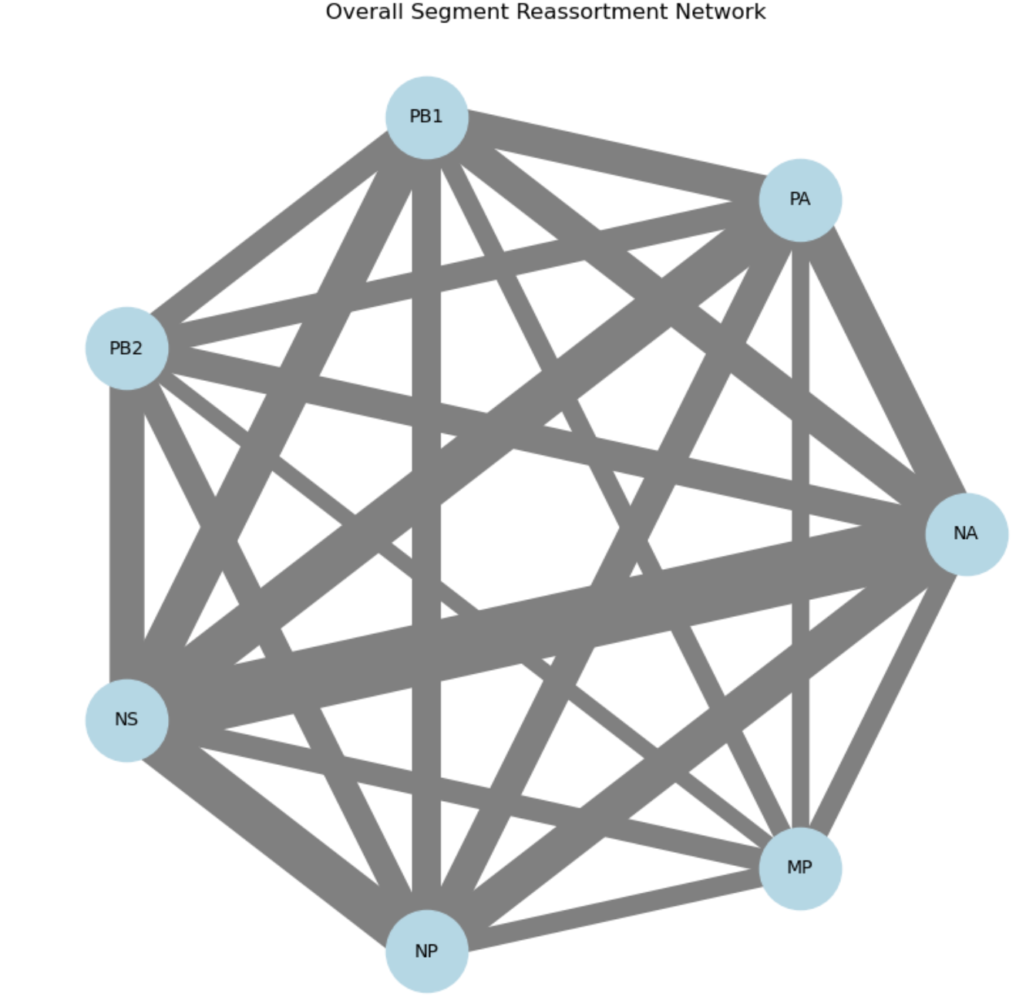
Network vis
This is for whole tree
Thickness scaled by a factor 0.1

Slide 29
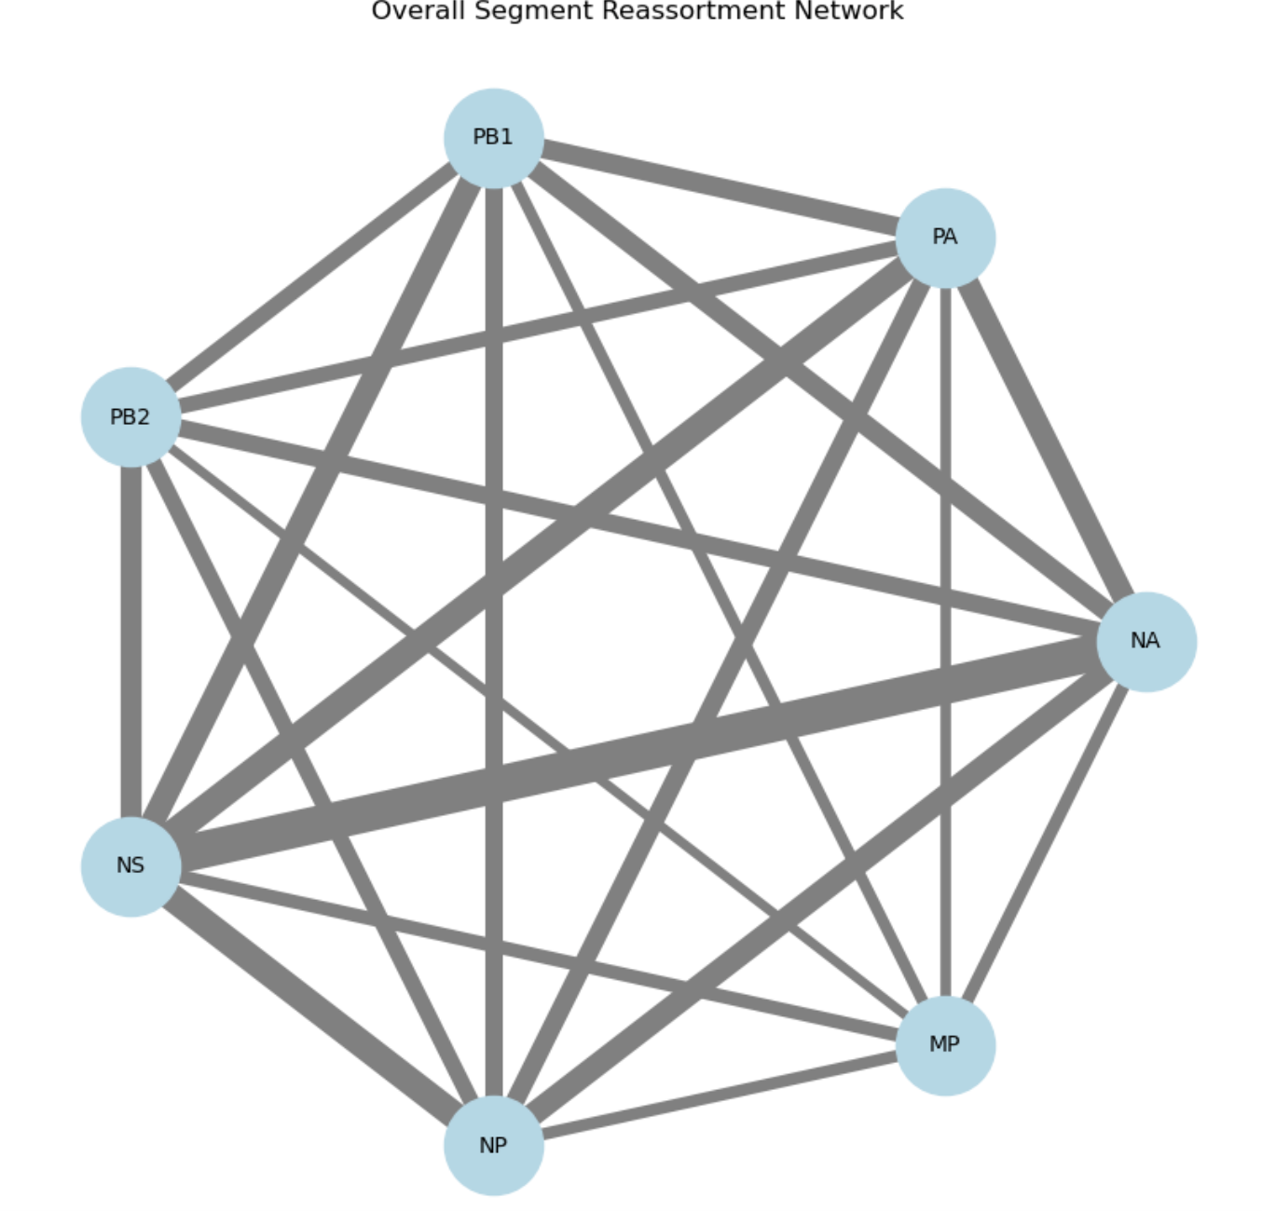
Network vis
This is for whole tree
Thickness scaled by a factor 0.05

